Slide 1
Teachers AND THEIR RELATED BEHAVIORS
Staff Training workshop a Kakumiro District on 3rd Janurary 2023
By Mwebembezi Johnie Kishate
Education Transformation initiatives Uganda

Slide 2
Major TYPES & BEHAVIOR OF teachers
Active
Mediocre / Middle line
Conformists
Saboteurs
Sheep

Slide 3
Active
Results oriented
Vigilant
Cooperative
Easy going
Aims higher
Creative
Innovative
Positive attitude
Self driven
Enthusiasm

Slide 4
Active cont……
Knowledgeable
Good practices
Efficient and exemplary

Slide 5
Mediocre
Average
Moderate of low quality
Low value
Ordinary
Normal or common
With no special or distinctive features

Slide 6
Conformist / Cynical / Alienated
Yes man
Hides incompetence
Fear
Ignorance
Not good not bad
Doesn’t show his opinion clearly
Disregarding
Distrustful

Slide 7
Saboteurs
Destroys
Damages
Uncooperative
Negative attitude
Cliquing
Disorder
Hypocrite

Slide 8
Sheep / passive
Docile
Incompetent
Easily influenced or led
No decision
No yes or no
Not bad not good
Byafa ndimu
No results no explanation

Slide 9
TYPES OF BAD GROUPS IN AN ORGANIZATION
Cabals
Cliques
Traders in chaos

Slide 10
Cabals
Group of opposition
Un united
Promotes their private moves
Secret plots
Usually planning for a downfall
Always very few i.e. 03/50 people

Slide 11
Cliques
Small group of people with shared interests e.g. seniors, bachelors, women, cooks
Features in common
Spend time together and don’t allow others to join
Good at dodging
Have an association for pork
Plan B
Not good
Criticisers

Slide 12
Traders in chaos
Beneficiaries of conflict
Plans chaos, conflict
Ill intentious
Hidden motives
His business is chaos
Sadoline
Pretends to be good.

Slide 13
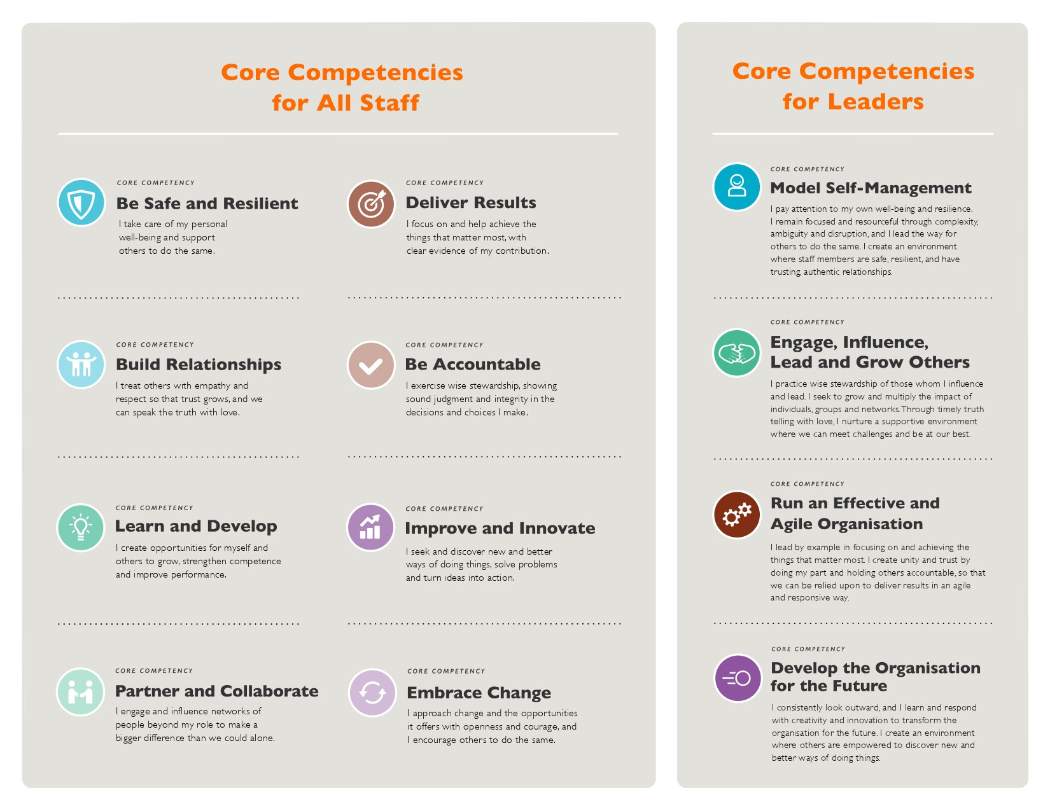

Slide 14
CORE COMPETENCES FOR ALL STAFF

Slide 22
THANK YOU

